Slide 1
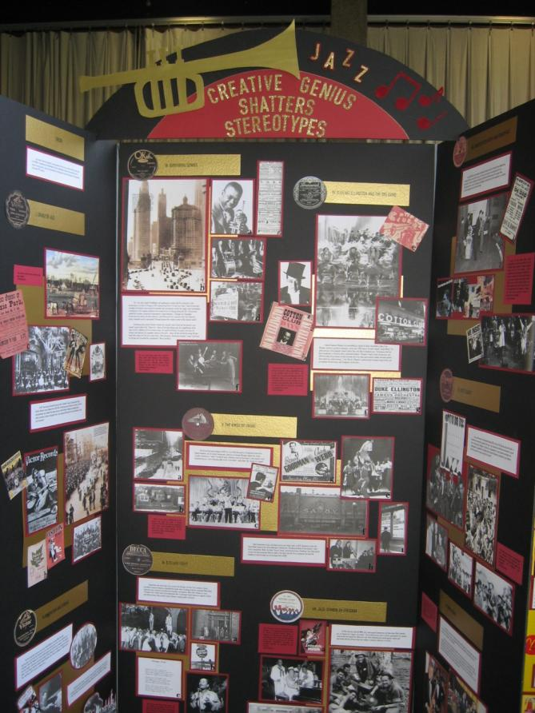
History Fair:
Maintaining Social Studies Content in an ELA World
Presented by Cheryl Hinchey
Schaumburg
School District 54

Slide 2
Mead junior high school
95/95 school on ISAT
Reading and Math top priorities
MAP: Reading and Math tested 3 times a year
Salary incentive if goals are met in Reading and Math
ELA standards on the report card for Social Studies and Science – in addition to content standards
Students removed from other classes (art, music, PLTW, Spanish) if help needed in ELA and Math
After school opportunities offered to improve Reading and Math skills

Slide 3
Mead junior high school
ELA/MATH ACADEMY
95/95 school on ISAT
Reading and Math top priorities
MAP: Reading and Math tested 3 times a year
Salary incentive if goals are met in Reading and Math
ELA standards on the report card for Social Studies and Science – in addition to content standards
Students removed from other classes (art, music, PLTW, Spanish) if help needed in ELA and Math
After school opportunities offered to improve Reading and Math skills

Slide 4
What happened to Social Studies?
In a 40 minute class period:
20 minutes must be spent in a guided reading activity
Assessments must include an ELA section with emphasis on one of the Illinois ELA standards
All teachers now have SS and ELA endorsements

Slide 5
What happened to history?
The philosophy of the school room in one generation will be the philosophy of government in the next.
--A. Lincoln

Slide 6
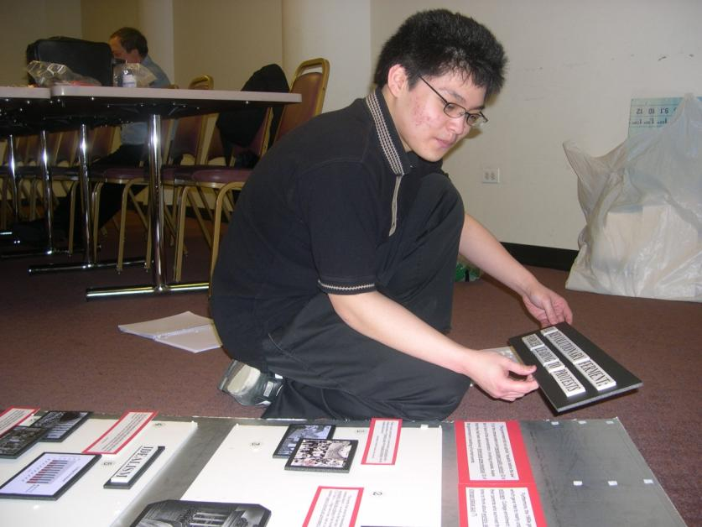
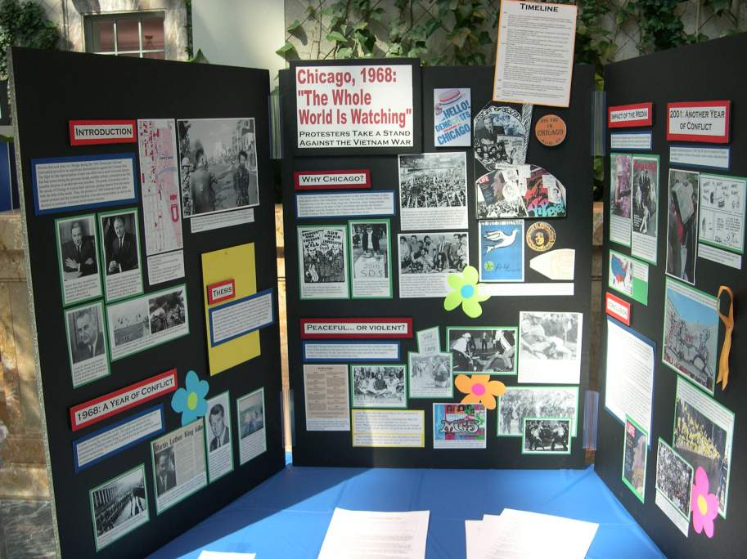
How to Survive in an ELA world
THINK
DO
MAKE HISTORY

Slide 7
History fair
Moves students from copiers (cut-and-paste) to historians who investigate
Asks students to think historically and not just repeat facts
Engages students through historical inquiry
Expects a rigorous research process.
Culminates in an optional competition.
Explores history through ELA standards

Slide 8
History Fair process encompasses the Illinois reading standards
Standards taken from ISBE website
1. Cite text evidence to support analysis of text. | 5. Understand meanings and connotations of words in context
2. Determine a central idea | 6. Determine author’s point of view and how it is conveyed
3. Summarize a text distinct from opinion/judgment | 7. Integrate information from various sources and develop a coherent understanding
4. Analyze how a key concept is introduced, illustrated, and elaborated in a text | 8. Comprehend non-fiction text with scaffolding to the high end of the range

Slide 9
History Fair PROJECTS & ILLINOIS WRITING STANDARDS
Writing Standards from ISBE Website
1. Write arguments to support claims. | 4. Use transitions to show relationships among claims and reasons.
2. Introduce claims and organize clearly. | 5. Establish and maintain a formal style.
3. Support using credible sources. | 6. Provide a conclusion that follows from the argument presented.
Common Core and National History Day

Slide 10
Rule book
1. Sample Copy
2. Entire rule book on the National History
Day website (nhd.org)
http://www.nhd.org/images/uploads/RuleBook14.pdf
3. Easy to print handbooks on Chicago
History Fair website http://www.chicagohistoryfair.org/history-fair/history-fair-rules-a-guidelines.html

Slide 11
Product choices
Website
Documentary
Historical Performance
Research Paper
Exhibit Board

Slide 12
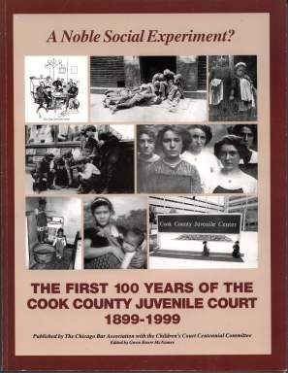
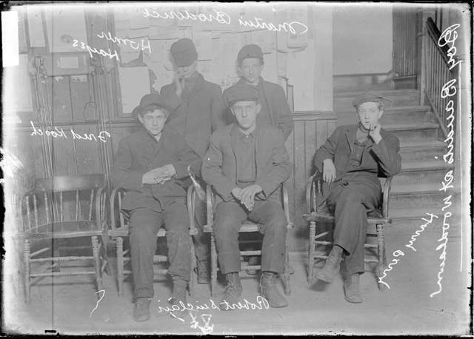
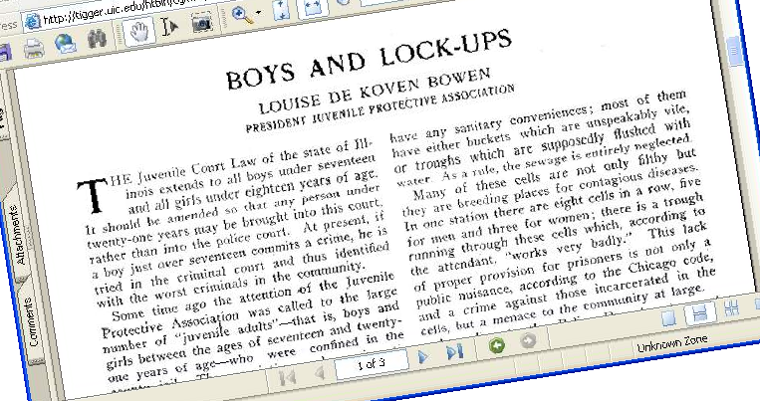
History Fair: a 5 Step uphill journey!
5. Tell Your Story!
4. Develop an Argument
3. Analyze Your Sources
2. Take the Research Journey
1. Ask Questions and Find Your Topic

Slide 13
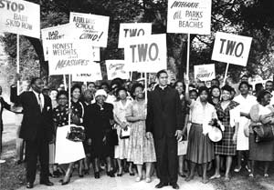
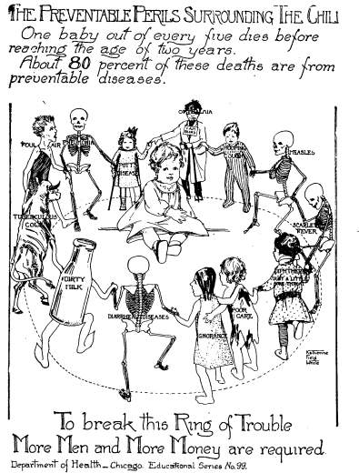
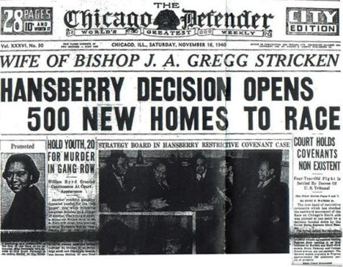
USE PRIMARY SOURCES AS EVIDENCE
Speeches
Letters
Photographs
Interviews
Diaries
Posters, flyers, signs
Minutes or reports, government documents
Court documents
Newspaper articles
Political Cartoons

Slide 14
Judging Criteria for History fair
Historical Quality
(60% of score)
1. Historical Accuracy
Determines that sources are viable and reputable
Explains cross check of sources
2. Historical Context
Illustrates how historical event influenced and was influenced by the social, cultural, political and economics of the time period
3. Analysis and Interpretation
Demonstrates critical thinking
Asks historical questions
Develops and defends an historical interpretation
Identifies bias
4. Use of available primary sources
Compares and critiques sources--documents, images, oral interviews, etc.
Evidence of the use of bibliographies to locate primary sources
5. Wide research
Reflects wide reading in multiple sources, including primary and secondary materials
6. Balanced Research
Represents competing perspectives
Identifies biases

Slide 15
Project Example: Website
weebly.com
1-5 students
1,200 student words
Up to 100 MB
Navigational menu
Sample

Slide 16
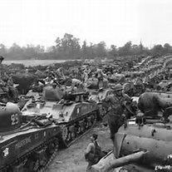
Project example: documentary
1-5 STUDENTS
10 MINUTES MAXIMUM
NARRATED BY STUDENTS
BURN TO DVD OR SAVE ON A FLASH DRIVE
“KEN BURNS” STYLE
Sample
from www.azski.com

Slide 17
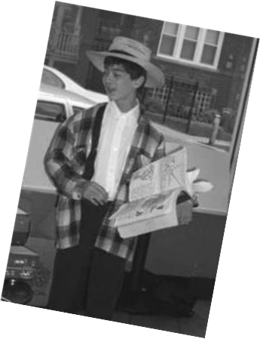
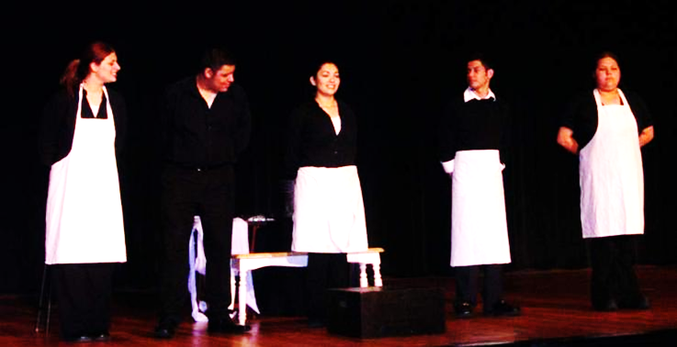
Project example: historical performance
1-5 students
10 minutes
Memorized
Suggested props,
sets, costumes

Slide 18
Project example: research paper
Student must work alone.
1,500-2,500 words
Parenthetical citations or endnotes
MLA or Turabian
10 or 12 font, double-spaced
Print on white paper with one inch margins
TITLE IX
By Akanksha Shah
“Never doubt that a small group of thoughtful, committed citizens can change the world. Indeed, it is the only thing that ever has.”
Margaret Mead
If recent history is any indication, this year over half of medical school applicants will be women. This was not always the case. In 1975, when Geri Cannon applied to medical university, she was not trying to make legal history or improve women’s rights – she was simply trying to fulfill her lifelong dream. Unfortunately for her and fortunately for many of America’s women, she was turned down. Her eight medical school applications snowballed into a Supreme Court case of great importance. It was Cannon’s case that not only added muscle to Title IX, but also struck a blow against age discrimination. In true American spirit, one unassuming suburban couple became pioneers by standing up for women’s rights with utter conviction and brought about great changes in the landscape of education.
Extremely influential in higher education, Cannon v. University of Chicago was an important court victory for women under Title IX. Championed by John and Geraldine Cannon, this case empowered women and innovated how Title IX could be used in the pursuit of gender equality.

Slide 19
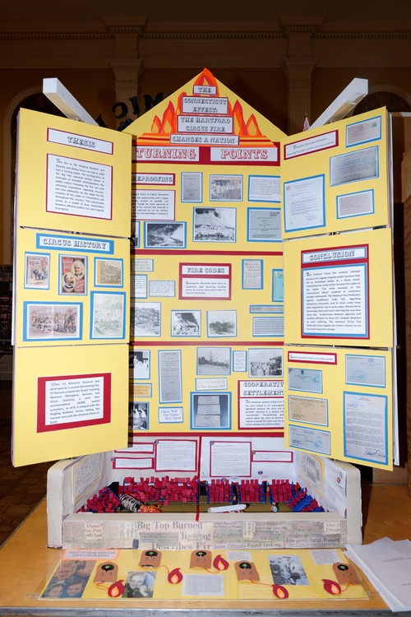
Project examples: Exhibit

Slide 20
Competition
Your school/district conducts a school history fair.
Your top entries compete at the Regional History Fair.
Regional Qualifiers are sent to Springfield for the State History Expo in May.
Two state qualifiers in each category are sent to National History Day in College Park, Maryland in June.

Slide 21
resources
www.ChicagoHistoryFair.org
Resource directory, professional development, ideas for topics, knowledgeable staff, rules and entries for competitions, teacher lesson plan ideas
www.nhd.org
National equivalent to above
http://libguides.chicagohistory.org/historyfair
Chicago History Museum – special tab with bibliographies already created for History Fair students
http://www.loc.gov/teachers/classroommaterials/primarysourcesets/
Library of Congress organized sets of primary sources
cherylhinchey@sd54.org

Slide 22
History Fair
We Go
Way Back

